Slide 1

Hangman
Alex Xu, Brian Jeong, Pratik Gongloor

Slide 2
Inspiration
Design a hangman game that can be played on the go
Too many ads and in-app purchases detract from the versions of the game currently on the market
Very minimalistic in design, to make it easy to pick up and play for people of all ages

Slide 3
How the Game Works?
Program chooses a random word from the 19,000 possible words
Loads up Starting Screen
Each wrong guess, a new body part is added. After 6 wrong guesses the game is over and ends in a loss
If the word is correctly guessed before 6 wrong guesses, the game is won

Slide 4





How the Game Works?
As each letter is guessed, a new body part is added to the figure.
Once the man is complete:

Slide 5
Game Over (Death Animation)

Slide 6
Design
WrongGuesses
Man
Type
Slot

Slide 7
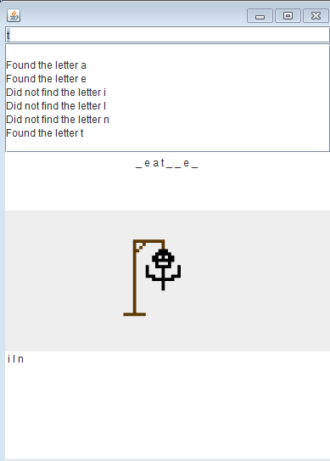
Type Class
HashSet to avoid duplicate guesses
Processes guess, check if it exists in word
Main component of the GUI
Generates multiple panels for each component

Slide 8
Slots Class
Keeps track of the letters that are guessed and if they correlate with the word that the program randomly chose.
Creates an array of underscore characters that go along with the number of characters in a given word
Class receives a letter guessed by a user, and if the letter is in the word, the underscore is replaced by the letter.
Array is then displayed and updated with every guess.

Slide 9
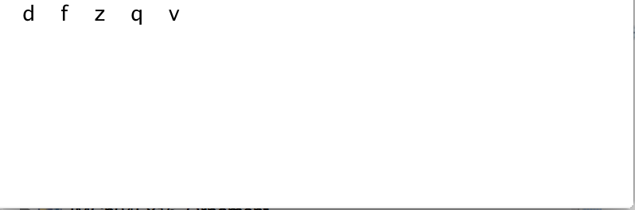
WrongGuesses Class
This class takes care of the creation of the man after the user guesses incorrect letters
It creates a Man object alongside an area which displays letters the user has already guessed

Slide 10
Man Class
Loads images based on stage of game
The "essence" of hangman!

Slide 11
Future Application
Can be used for study purposes
Similar to the Quizlet app, users can be forced to play the game with vocabulary words
Make the hangman customizable, perhaps with different death animations or more body parts

